Slide 1



Using the secrets of behavioral science to influence security
Masha Sedova, Co-founder
masha@elevatesecurity.com
Megan Caldwell, Head of CSM
megan@elevatesecurity.com

Slide 2




About Masha
Computer security meets behavioral science
Co-Founder, building security behavior change platform
Built and ran Salesforce trust engagement team
Passionate about transforming security behaviors from “have to” to “want to”

Slide 3



About Megan
Behavioral change at enterprise scale
Head of Customer, partnering to ensure our customers success
Led customer and strategy teams in healthtech startups
Passionate about working with companies that see their employees as their biggest asset

Slide 4
Agenda
Defining the problem
Who are your customers?
Key Behaviors
Diagnostic tools: Why wont they change?
Defining culture and competing priorities
Competing Security Culture Framework
Remediation tools: Getting them to change
Five whys
Behavioral Design Approach
Ability
Triggers
Motivation

Slide 5


Who are your customers?
New hires
Executives
Front-line employees
Middle Management
Developers
IT department
Compliance
Security team
Other roles?

Slide 6
What do you want your customers/co-workers to do differently?
Discussion

Slide 7
Defining Key Behaviors
The smallest set of actions that lead to the results you want
“I will lose 10 pounds and 5% body-fat by September 1 of this year.”
“I need to eat fewer calories than I burn.”
“I’d love to lose weight”

Slide 8
Can we re-think our asks as a key behavior?
Discussion

Slide 9
Elevate Security | Datasheet
Typical Goals of a Security Behavior Change Program
Phishing
Reduce click-through rate
Increase reporting rate
Using Internet Safely
Reduce amount of unknown and malicious sites visited
Reduce number of dangerous downloads on the network
Handling Sensitive Information
Reduce amount of sensitive information given over the phone
Reduce amount of sensitive data stored outside of the network
Reduce number of sensitive documents not shredded
Reduce data inappropriately stored (i.e. on local laptop)
Reduce sensitive data sent over
email
Password Hygiene
Increase number of people who use a password manager
Reduce password reuse across sites
Social Media
Reduce amount of sensitive data posted on social media sites
Physical Risk
Reduce unauthorized badge surfing attempts
Increase number of clean desks
Increase number of people who lock their screens when stepping away
Working Safely Outside the Office
Increase number of people connecting via VPN
Increase number of privacy screens used
Decrease number of insecure Wifi connections used
Reduce the number of public conversations
FANTASTIC METRICS FOR MEASURING SECURITY CULTURE
AND WHERE TO FIND THEM
Creating a positive security culture starts with measurable behavior change. This means relying on some fantastic metrics, and knowing where to find them.

Slide 10
Elevate Security | Datasheet
Where to Source and Verify Security Behavior Change Metrics
 | Technology sources of data | How to test/verify
Using the Internet Safely | Proxies - Bluecoat, ZScaler, Websense Endpoint - SentinelOne, Carbon Black, Cylance, Symantec, Trend | These solutions, if they have an API and results are associated with a user and not a machine or IP will give very good insight into this behavior. Phishing of employees
Handling Sensitive Information | Proxies - Bluecoat, ZScaler, Websense DLP - Vontu | These solutions, if they have an API and results are associated with a user and not a machine or IP will give very good insight into this behavior. Social Engineering could be done through custom-built tools like phishing/vishing simulations.
Password Hygiene | Password Managers - LastPass, Keypass Active Directory Hash analysis | Looking at exposed password sets and matching against employee names.
Protecting Mobile Devices and Information | Endpoint - Lookout, ESET, Trend, etc MDM Vendors - Airwatch, MobileIron, Good, etc | For endpoint malware solutions, if they have an API and results are associated with a user and not a machine or IP it will give very good insight into this behavior.
Protecting and Disposing of Data Securely | Proxies - Bluecoat, ZScaler, Websense DLP - Vontu | Aggregate pentest findings for insecure data storage.
Protecting Against Physical Risk | N/A | Manual assessments of unlocked machines, badge surfing, and clean desk policy Video reviews of a set of doors at the same time each week for a period of time. Surveys
Working Safely Outside the Office | These only detect bad outcomes, not bad behavior. Proxies - Bluecoat, ZScaler, Websense Endpoint - SentinelOne, Carbon Black, Cylance, Symantec, Trend | Surveys

Slide 11
Why aren't they doing it now?!

Slide 12
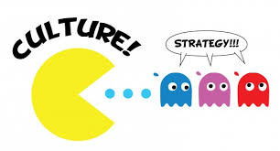
“Culture eats strategy for breakfast.”
-Peter Drucker

Slide 13
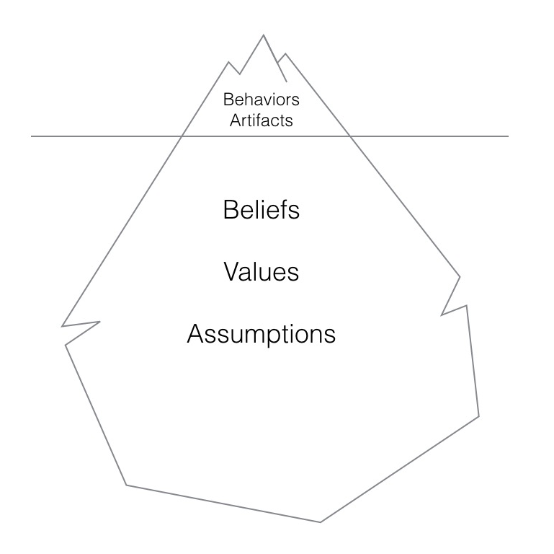
What is Culture
“The way we do things around here...”
Invisible until you clash with a different one
Incredibly hard to change unless you are starting one from scratch...
Our experiences shape our beliefs, values, assumptions.
Experiences
Notes:
Behavior is not something that exists independently outside of culture.
Effectuating behavior change along is extremely resource intensive. Change what someone believes, what drives them to make decisions in the first place, and they will do the behavioral work for you.

Slide 14

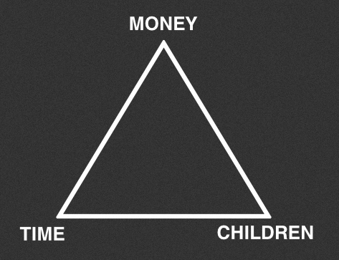
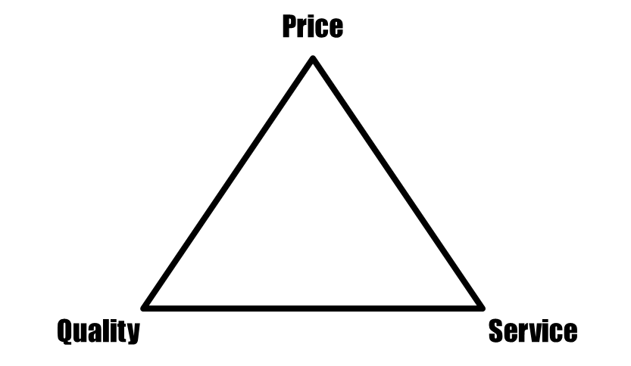
Competing Priorities
Pick two

Slide 15
Opposing forces in an employee’s business decisions
Deadlines
Security
Cost
Bonus
Security Debt
Security Failure

Slide 16
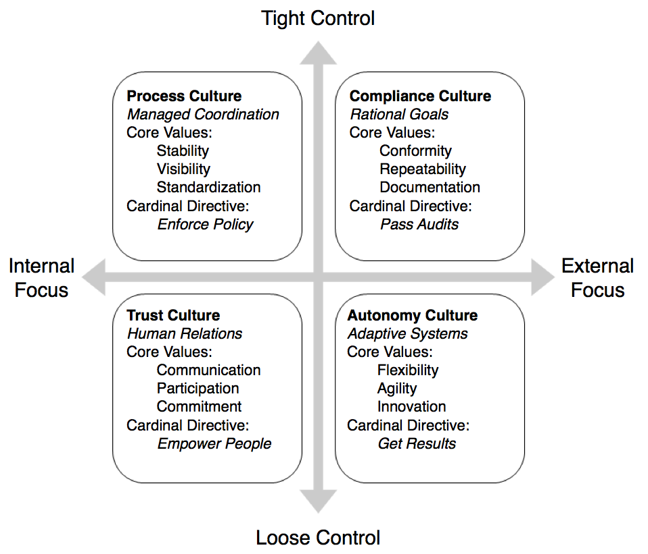

The Competing Security Cultures Framework
Notes:
Think of the CSCF as a personality test for your security program…
Is your program a control freak? A conformist? A cowboy? A community builder?
How do different personalities get along?

Slide 17
Exercise:
Security Culture Diagnostic Survey
http://lancehayden.net/resources/SCDS.zip

Slide 18
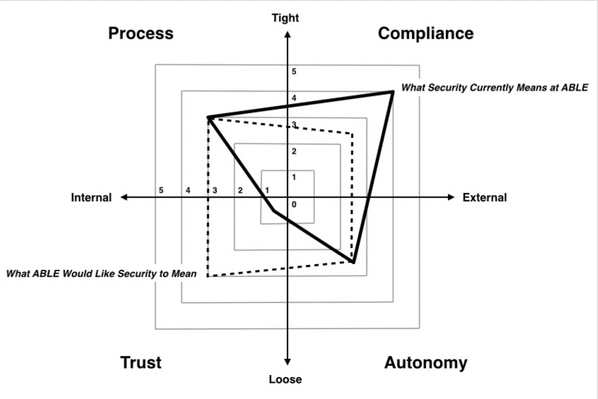
Results of SCDS

Slide 19
How do we get them to change?

Slide 20
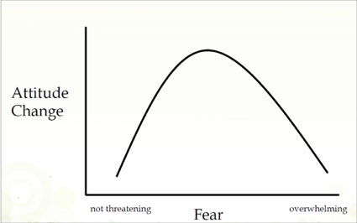
Does fear lead to behavior change?
The test shows that you must arouse a person to the benefits of a change and provide a clear path of action for that change to facilitate action.
(Leventhal, 1970)

Slide 21
Root Cause Analysis

Slide 22

Understanding the Problem
The Five Whys Tool
Ask the five whys to get to the root of a problem.
Notes:
Does anybody normally use the 5 Whys…
By repeatedly asking the question ‘why?' (use five as a rule of thumb), you can peel away the layers of an issue, just like the layers of an onion, which can lead you to the root cause of a problem. The reason for a problem can often lead into another question; you may need to ask the question fewer or more than five times before you get to the origin of a problem.
The real key is to avoid assumptions and logic traps and encourage the team to keep drilling down to the real root cause.
The ability to ask, "What if?" is an essential part of every executive's skill set.
Contrast this with the more traditional definition of 'hypothesis,' which is a best-guess explanation that's based on a set of facts and can be tested by further investigation. With a disruptive hypothesis, however, you don't make a reasonable prediction (if I charge the battery, the phone will work). Instead, you make an unreasonable provocation (what if a cell phone didn't need a battery at all?). The difference between prediction and provocation, to paraphrase George Bernard Shaw's famous line, is the difference between "seeing things as they are and asking, 'Why?,' or dreaming things as they never were and asking, ?What if??" In our fast-changing world, when business certainties are no longer certain, the ability to imagine things as they never were and ask, "What if?," is an essential part of every executive's skill set.

Slide 23
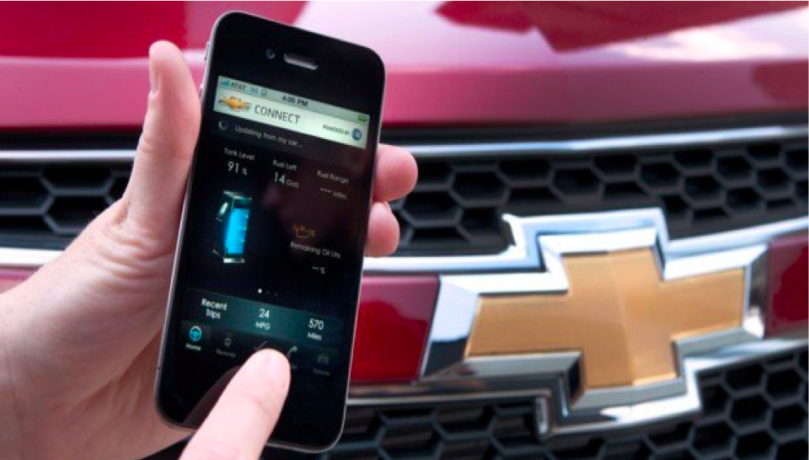
The Five Whys- Example
Problem Statement:
My car battery is dead
1. Why? – The alternator is not functioning.
2. Why? – The alternator belt has broken.
3. Why? – The alternator belt was well beyond its useful service life and has never been replaced.
4. Why? – I have not been maintaining my alternator belt according to any recommended service schedule.
5. Why? I didn’t realize this had to be done.
Notes:
Real root cause findings:
From a new product perspective, GM realized that customers might benefit from something as simple as pre-programmed reminder that alerts them when the car is approaching each maintenance interval. This ultimately results in a new product line: GM’s Onstar app. It takes engine data and then email a monthly status summary (e.g. 15% of oil life remaining – time to schedule service)
In 2011, not long after its release there were over 6 Million users. 1.4B business (paying between 200/400 a year)

Slide 24
Investigate Root Cause
Can this be solved with technology?
Do it! Changing mindset is the hardest way to go about enforcing change.
“I didn’t realize that security was part of my job.”
Communication, marketing, awareness campaigns
​“I didn’t know what to do about it.”
Training and skills
​“I didn’t have the resources or support to do it.”
Management alignment
“I didn’t want to.”
Gamification and incentives

Slide 25
What do you think is the root cause of your co-workers not doing the requested security behavior?
Discussion

Slide 26
Behavioral Design Approach

Slide 27
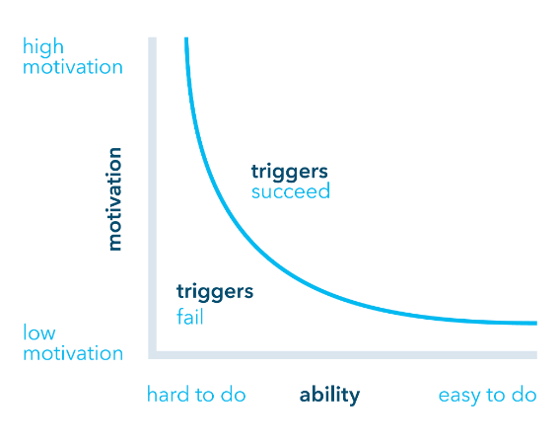
Behavior Change Model
By Dr. Bj Fogg

Slide 28

Key Factors
Motivation
Ability
Trigger
Notes:
I didnt used to run but I change that.
Friend” Do you want to go running?”
I am able to run. He reminded me to run. But I have no motivation to run
Broken leg: Not able to run
Trigger: Ability and motivation to run, but no one reminded me.

Slide 29
Security Behavior Change
Ability
Training
Technology
Triggers
Effective communication
Phishing, Social Engineering, etc
Motivation
Making it personal
Positive incentives
Gamification

Slide 30
Ability

Slide 31

Ability
Training
Deliver knowledge to employees based on their role and ability level
Technology to do the job
Management support

Slide 32
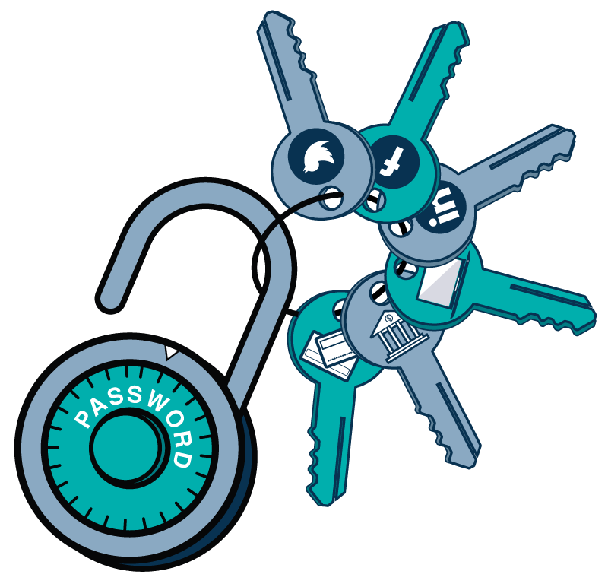
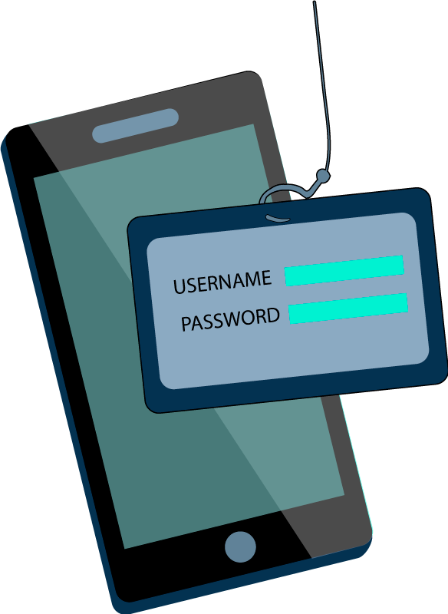

Security Action Can Be Simplified
Having secure passwords for all sites
Reporting suspicious activity
Stop tailgating
Remember 20 unique characters across 40+ sites
Look up correct email, reporting guidelines & send
HARD
Social Accountability
EASY
Install a password manager
Install a “Report” button
Install a man-trap or in/out badging
Notes:
Easy to Do, Low Motivation Needed
The first choice security teams have is to make a behavior easy to do. Where possible, an action should be simplified as much as possible, ideally through the use of technology/automation to require little motivation on the part of the employee to take action.

Slide 33
Are there elements of ability that you can incorporate?
Discussion

Slide 34
Triggers

Slide 35


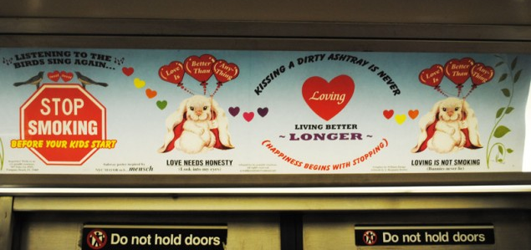
Communications (aka Triggers)
36.5 million adults in the United States currently smoke cigarettes

Slide 36
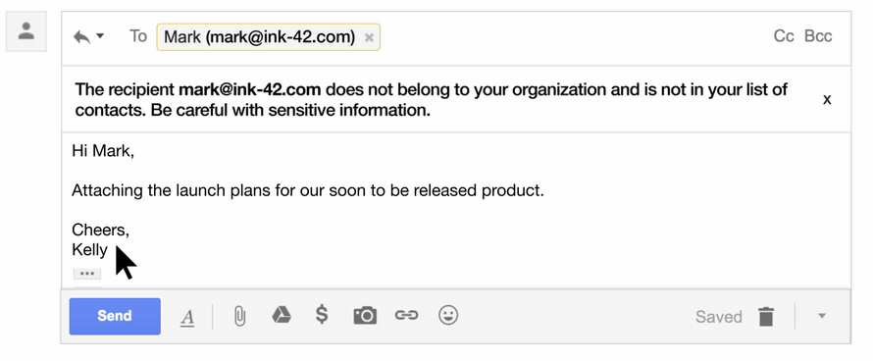
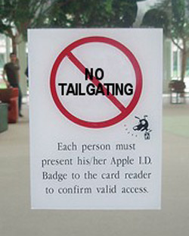
Security Triggers

Slide 37
Are there triggers elements that you can incorporate?
Discussion

Slide 38
Motivation

Slide 39
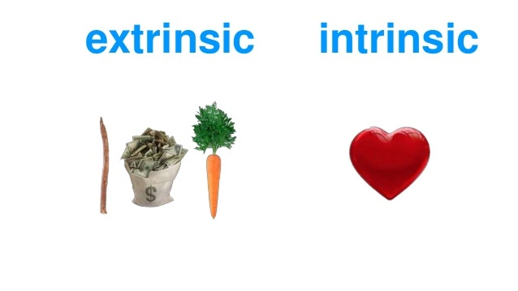

What Motivates Us?
“People will do things because they matter, they are interesting, part of something more important. “
Daniel Pink, Drive
Pride
Interest
Achievement
Curiosity
Praise
Punishment
Money
Notes:
With both the predictable and unpredictable events mentioned above, all the examples were driven by negative motivations. The underlying drivers are sentiments like:
“I dont want this to happen to me”
“I dont want to get fined”
“I dont want to lose customers.”
These leverage the categories that security is famous for: Fear, Uncertainty, Doubt. In security, do we have naturally positive motivations? We have bug bounties, organizations have security champion programs, and some have reporting recognition systems. But these fall in less than 20% of surveyed organizations.

Slide 40
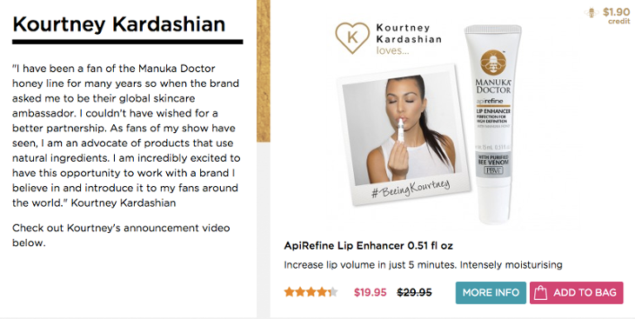

The Power of Social Proof

Slide 41
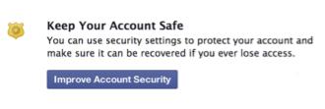
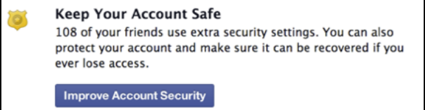
Social Proof
The study of Sauvik Das of Georgia Institute of Technology found that a Facebook prompt to install security controls was 1.36x more successful when using social proof.
Control
Social Context
Notes:
With both the predictable and unpredictable events mentioned above, all the examples were driven by negative motivations. The underlying drivers are sentiments like:
“I dont want this to happen to me”
“I dont want to get fined”
“I dont want to lose customers.”
These leverage the categories that security is famous for: Fear, Uncertainty, Doubt. In security, do we have naturally positive motivations? We have bug bounties, organizations have security champion programs, and some have reporting recognition systems. But these fall in less than 20% of surveyed organizations.

Slide 42
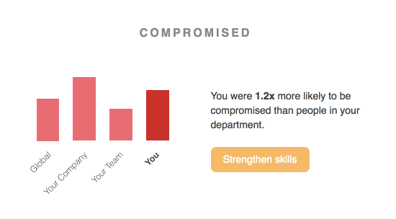
Notes:
With both the predictable and unpredictable events mentioned above, all the examples were driven by negative motivations. The underlying drivers are sentiments like:
“I dont want this to happen to me”
“I dont want to get fined”
“I dont want to lose customers.”
These leverage the categories that security is famous for: Fear, Uncertainty, Doubt. In security, do we have naturally positive motivations? We have bug bounties, organizations have security champion programs, and some have reporting recognition systems. But these fall in less than 20% of surveyed organizations.

Slide 43
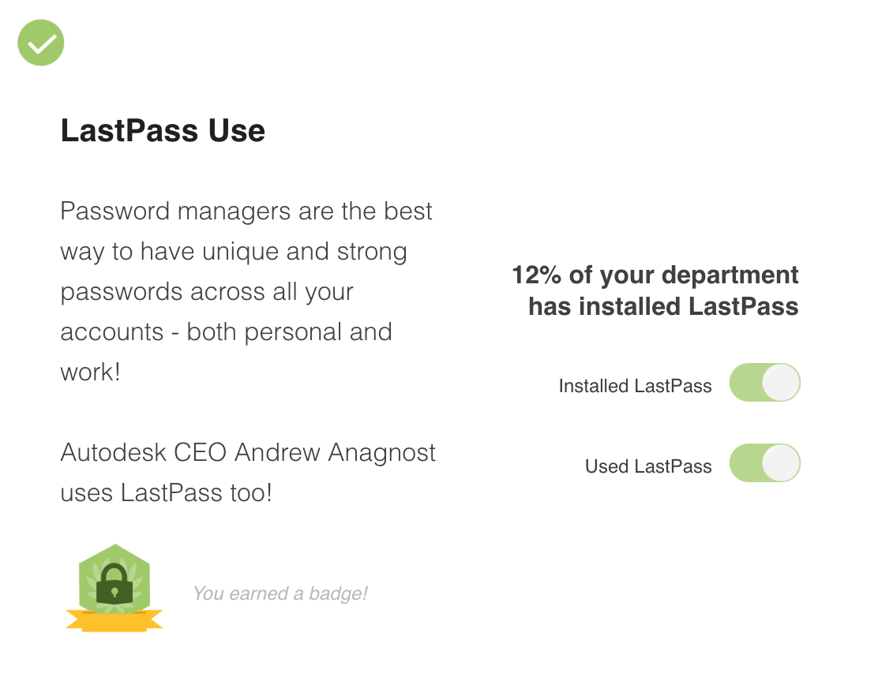
Notes:
With both the predictable and unpredictable events mentioned above, all the examples were driven by negative motivations. The underlying drivers are sentiments like:
“I dont want this to happen to me”
“I dont want to get fined”
“I dont want to lose customers.”
These leverage the categories that security is famous for: Fear, Uncertainty, Doubt. In security, do we have naturally positive motivations? We have bug bounties, organizations have security champion programs, and some have reporting recognition systems. But these fall in less than 20% of surveyed organizations.

Slide 44
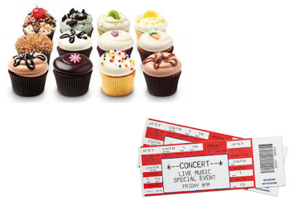
Other reward types
Parking spots
Lock picking classes
Concert tickets
Lunch with an exec
Kudos from C-level
Cupcakes for your team
Awards ceremony
Free lunch
T-shirts

Slide 45


Market Norms
Assigning a monetary value to an exchange
Social Norms
The actions among friends that are not based on money.
Dan Ariely, PhD
Predictably Irrational

Slide 46
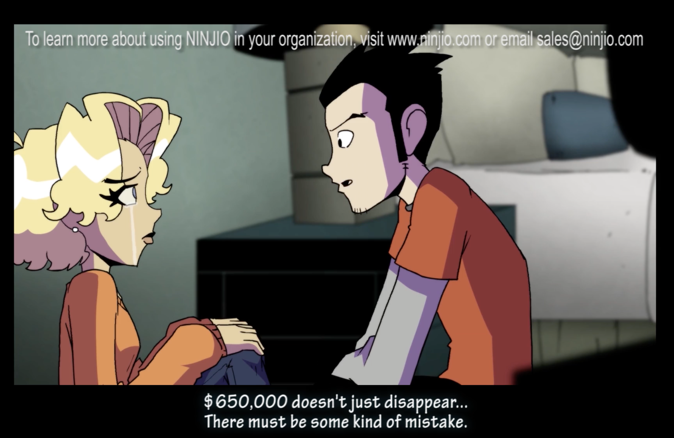
Connecting it to purpose
Explaining the “why” behind your security behaviors:
Why are you asking for this change?
Why does it matter?
Why should someone care?
Notes:
Use real case studies. Use faces and names.

Slide 47
Are there elements of motivation that you can incorporate?
Discussion

Slide 48

Putting It All Together

Slide 49
Creating a Phishing & Reporting
Behavior Change Campaign
Goal #1: Reducing the percentage of malicious links that are clicked in a phishing email campaign to be 12% or less as an average across all difficulty types of phishing email.
Goal #2: At least 20% of recipients of an attack report it to security, regardless of the difficulty of the attack.

Slide 50
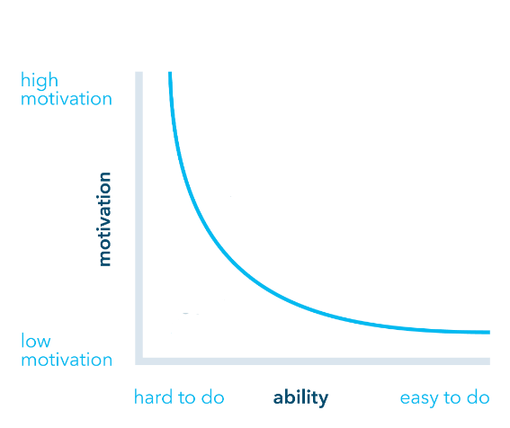
Phishing Campaign Model
Case studies of phishing related breaches
Leaderboard of top reporters
Thank you emails to employee + managers
Kudos of breach-prevention on company call.
Detection skills
Phishing practice
Reporter button
Safe sender

Slide 51
Thanks!
masha@elevatesecurity.com
megan@elevatesecurity.com
@hello_Elevate

